Slide 1
Introduction to the transcriptome assembly project
Kris Alavattam
Tsukiyama Lab
1/11/2023

Slide 2
This work necessitates the creation of a new transcriptome assembly built from the 4tU-seq data—but why? And what will we do with it?
Using quiescent yeast cells, we seek to perform a comprehensive characterization of cryptic transcription¹
An important, conserved feature of eukaryotic genomes is pervasive transcription
In S. cerevisiae, at least 85% of the genome is transcribed in cycling cells, resulting in substantial amounts of noncoding transcription
Near or overlapping annotated genes
On the antisense strand
Much of this noncoding transcription degrades on a shorter time scale than transcription detected by, e.g., RNA-seq—as such, it is termed cryptic transcription
Subsets of cryptic transcripts have been characterized and annotated through the knockout of RNA surveillance factors and chromatin modifiers^{2–7}
However, it is an ongoing mystery as to the functions of cryptic transcripts
Alison and the Tsukiyama Lab have shown that quiescent cells are enriched for noncoding transcription in general and antisense transcripts in particular
Thus, using quiescent S. cerevisiae as a model, Alison sought to perform a comprehensive characterization of cryptic transcripts
Alison performed 4tU-seq—also known as "nascent RNA-seq"
4tU-seq is a variant of RNA-seq that enriches for nascent transcription
4tU-seq detects low abundance and labile transcripts that are not detected with standard transcription readouts (unless analyzing cells defective for RNA degradation)
The goal: Identifying and characterizing noncoding and antisense transcripts detected at the entry to quiescence
This will be followed by experiments that infer and define the function of cryptic transcripts
Greenlaw et al., in progress
van Dijk et al., 2011
Wyers et al., 2005
Lykke-Andersen & Jensen, 2011
Schulz et al., 2013
Xu et al., 2009
Vankatesh et al., 2016
Notes:
XUTs (Xrn1 unstable transcripts): 33
van Dijk, E. L. et al. XUTs are a class of Xrn1-sensitive antisense regulatory non-coding RNA in yeast. Nature 475, 114–117 (2011)
CUTs (Cryptic Unstable Transcripts, Rrp6 and/or Trf4): 20, 34, 35
Wyers, F. et al. Cryptic pol II transcripts are degraded by a nuclear quality control pathway involving a new poly(A) polymerase. Cell 121, 725–737 (2005)
Davis, C. A. & Ares, M. Accumulation of unstable promoter-associated transcripts upon loss of the nuclear exosome subunit Rrp6p in Saccharomycescerevisiae. Proc. Natl. Acad. Sci. 103, 3262–3267 (2006)
Lykke-Andersen, S. & Jensen, T. H. CUT it out: silencing of noise in the transcriptome. Nat. Struct. Mol. Biol. 13, 860–861 (2006)
NUTs (Nrd1 Unterminated Transcripts): 36
Schulz, D. et al. Transcriptome Surveillance by Selective Termination of Noncoding RNA Synthesis. Cell 155, 1075–1087 (2013)
SUTs (Stable Unannotated Transcripts): 37
Xu, Z. et al. Bidirectional promoters generate pervasive transcription in yeast. Nature 457, 1033–1037 (2009)
SRATs (Set2 repressed antisense transcripts): 38
Venkatesh, S., Li, H., Gogol, M. M. & Workman, J. L. Selective suppression of antisense transcription by Set2-mediated H3K36 methylation. Nat. Commun. 7, 13610 (2016)

Slide 3
The 4tU-seq-derived assembly makes it possible to characterize cryptic transcription— but what does custom transcriptome assembly entail?
Why do we need a new transcriptome assembly, and what will we do with it?¹
An official, standard S. cerevisiae transcriptome assembly exists—but it doesn’t meet our needs
In Alison’s preliminary work examining nascent transcription at the entry to quiescence, she assembled ~5,500 transcripts— ~30% of which had no (same-strand) overlap with previous annotations
Thus, official (and other) annotations lack information for quiescence-entry transcription, including…
Noncoding transcription—e.g., antisense and intergenic transcripts
Alternative stop and start sites for transcripts
Upstream transcription—i.e., transcripts that start and stop within promotors
Using the 4tU-seq-derived transcriptome assembly, we seek to...
Determine the numbers of antisense (AS) transcripts in quiescence-entry (Q) versus G1-arrested (G1) cells, and examine the differences in AS transcription between the two states
Determine the numbers of intergenic transcripts in Q versus G1 cells, again examining the between-state differences
Determine the extent of altered transcription start or stop sites in Q cells
Find, tally, and characterize transcripts that have never been annotated
Having recorded coordinates for altered and/or novel transcripts, we will use the new assembly to...
Measure differential expression in Q versus G1 cells
Classify different kinds of noncoding transcription, inferring relationships between coding and noncoding transcription
Evaluate chromatin structure at classifications/kinds of loci
More...
Greenlaw et al., in progress
Notes:
Associated with bullet #2, sub-bullet #1
Are there changes in levels of transcription?
Are there positional changes such as changes in start or stop sites?
And, generally, “analysis [to estimate likely functions for given antisense transcript]—for example, are longer [antisense] transcripts [“more”] functional? [Antisense transcripts in] [c]ertain orientations [with respect to] genes? Does the relationship with the promotor matter? (This is very downstream. Your call how much detail you want to talk about it.)

Slide 4
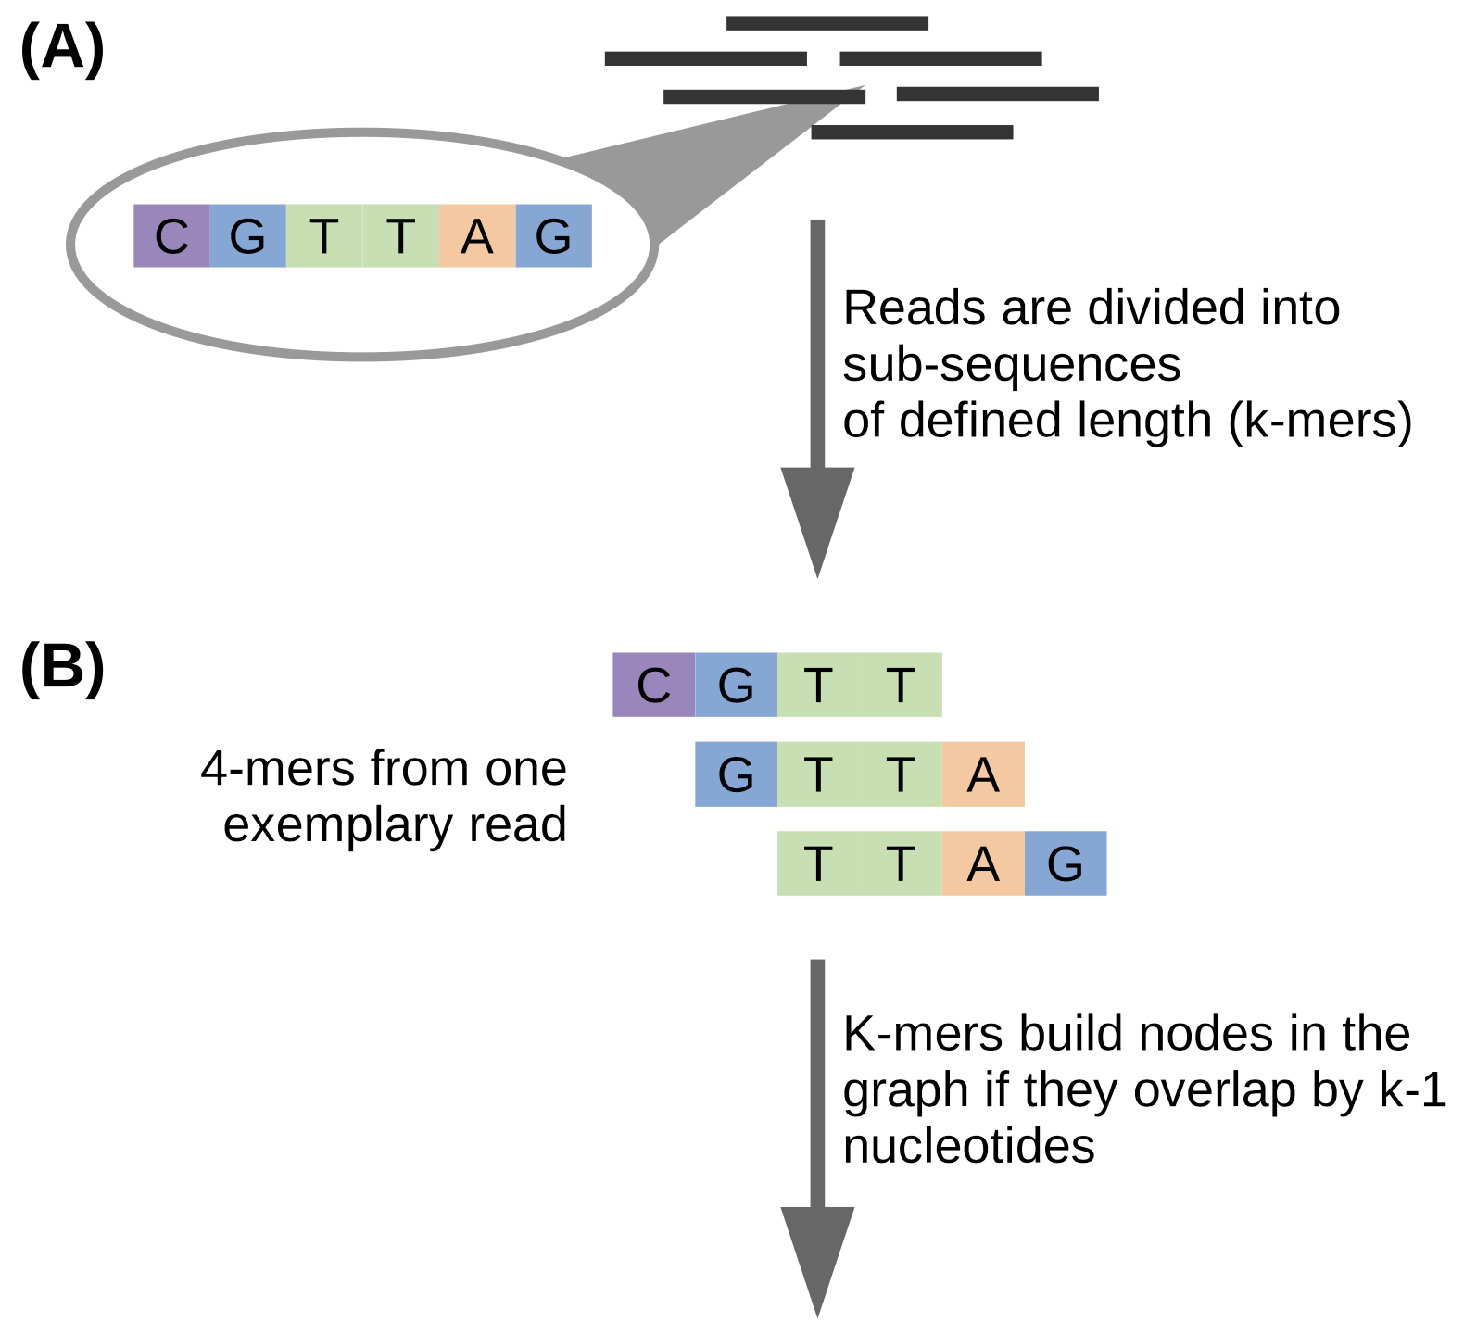
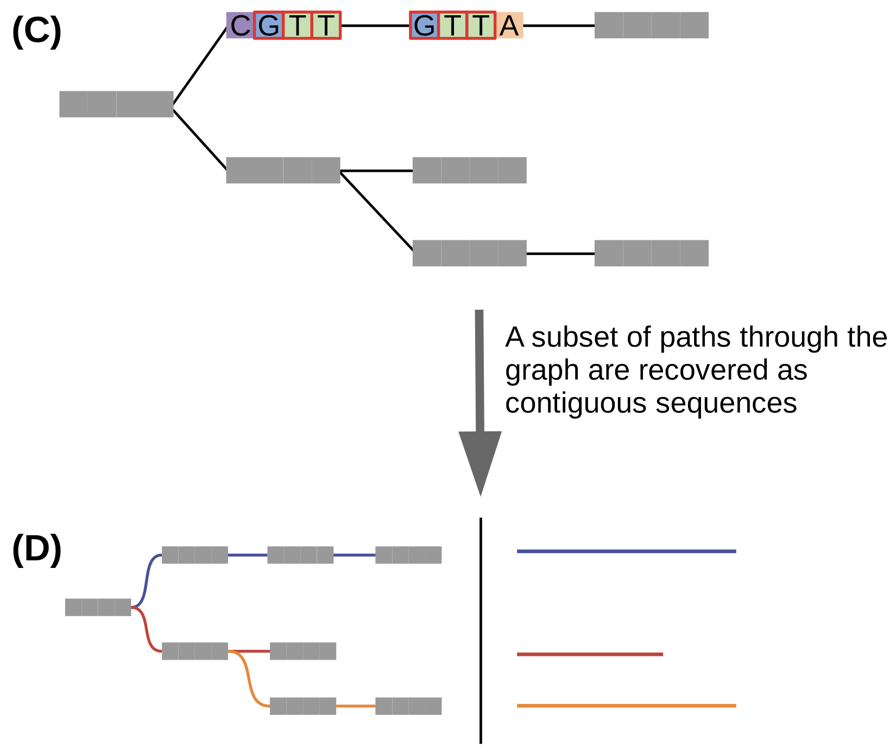
What is it to make a custom transcriptome assembly?
In transcriptome assembly, millions of reads are pieced together to accurately represent their genomic sequences of origin
Assembly is achieved by examining overlaps between reads—or subsequences thereof—in order to concatenate them into longer contiguous sequences (a.k.a., contigs)^{1,2}
Instead of whole reads, most assembly algorithms use k-mers—read-derived substrings of length k³—as assembly units
General steps of the assembly process
Construct a dictionary of all possible k-mers and their reads of origin
Represent the k-mers as nodes (a.k.a., vertices or “points”) in a graph
Form lines between points if they have an overlap of exactly k – 1 nucleotides
Extend paths until no further overlap-based extensions are possible³
Traverse and record each possible path through the graph: These are contigs, and they represent possible origin sequences for the k-mers
Martin & Wang, 2011
Bushmanova et al., 2019
Grabherr et al., 2011
Figure: Raghavan et al., 2022
Notes:
Raghavan et al.: Section “De novo transcriptome assembly”
¶2
Assembly algorithms are mostly based on using k-mers as assembly units instead of whole reads.
A k-mer is a sub-string of length k derived from a particular read [46].
The first step in the assembly process is to construct a dictionary of all possible k-mers (for a given k) and the reads these k-mers originate from.
Most modern assemblers are graph-based in that they represent the k-mers as nodes in a so-called De Bruijn graph (Figure 3).
Subsequently a contig is a path through the graph, where each distinct k-mer represents a vertex in the graph.
Edges are formed between two k-mer vertices if they have an overlap of exactly k-1 nucleotides.
In this way paths through the graph correspond to possible sequences the k-mers originated from (Figure 3).
Paths are extended until no further overlap-based extensions are possible [46].
Then each possible path through the graph is traversed and recovered as a separate contig corresponding to a single transcript.
¶3
…
Subsequently, post-processing steps may be implemented to filter and group contigs to yield a representative set of the assembled sequences.
De Bruijn graph-based assembly is sensitive to the choice of k-mer length as it dictates the set of contigs assembled by controlling the complexity of the graphs.
Citations
15. Martin JA, Wang Z. Next-generation transcriptome assembly. Nat Rev Genet September 2011;12(10):671–82.
56. Bushmanova E, Antipov D, Lapidus A, et al. rnaSPAdes: a de novo transcriptome assembler and its application to RNA-Seq data. Gigascience September 2019;8(9).
46. Grabherr MG, Haas BJ, Yassour M, et al. Full-length transcriptome assembly from RNA-Seq data without a reference genome. Nat Biotechnol May 2011;29(7):644–52.

Slide 5
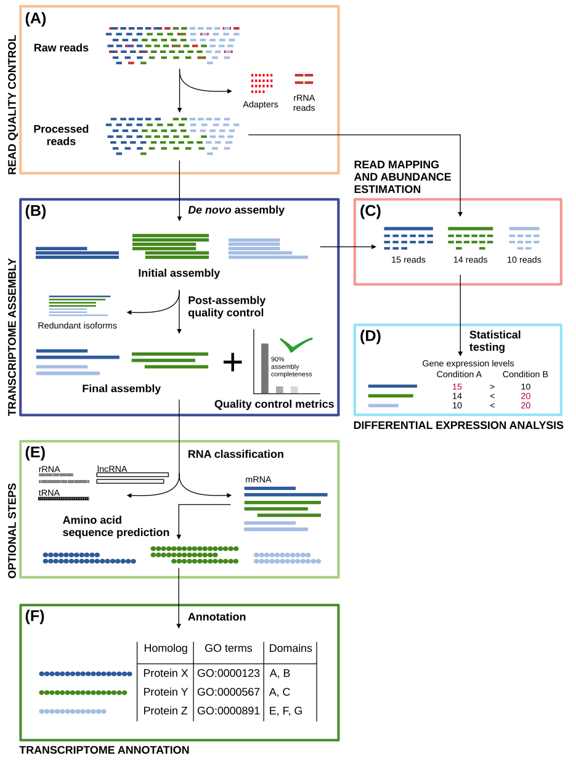
What is it to make a custom transcriptome assembly?
In general, reads can be assembled through one of two approaches:
Reference genome-guided: Assembly occurs through the alignment of reads to the reference genome
Reference genome-free—i.e., de novo: Assembly occurs using only the information contained in the reads
In our recent work, we leverage a hybrid strategy, assembling transcriptomes from the results of both approaches
...but before diving into that, it's important to discuss the general workflow for transcriptome assembly
Figure: Raghavan et al., 2022
Notes:
Rhind-et-al.: Materials and Methods: Transcript reconstruction from RNA-Seq and incorporation into gene annotations (p. 20)
¶1
Transcript reconstruction from RNA-Seq reads was performed using a hybrid approach leveraging genome alignments coupled with de novo RNA-Seq read assembly. RNA-Seq reads were first aligned to genome sequences using TopHat (73) requiring a minimum intron length of 25 bases and a maximum intron length of 1 kb. Unmapped reads were identified and realigned to the genome using the more sensitive BLAT (74) alignment tool. Based on genome alignment coordinates and strand-specificity, reads were partitioned into disjoint strand-specific ‘coverage regions’, and neighboring coverage regions within 1 kb were merged into larger regions. The reads corresponding to alignments in the merged coverage regions were subjected to de novo assembly as part of the transcript reconstruction process described below.
¶2
Prior to de novo assembly, operations were performed to mitigate the errant fusion of adjacent and minimally overlapping transcripts by considering the evidence for transcription contiguity based on read pairing support. A pair contiguity sensor was devised as follows: A 200 base window was slid across each covered region with a step size of 33 bases. The RNA-Seq fragments (defined by either read of pairs derived from single fragments) overlapping the first 50 bases (segment A) and the last 50 bases (segment B) of the 200 base window were identified as fragment sets (A, B). The contiguity of fragment coverage was computed as a Jaccard similarity coefficient: (AB)/(AB). Similarity coefficient values at or below 0.05 trigger a search for a covered region clip point. First, the smallest coefficient value within 100 bases is defined as a candidate clip point. If regions of greater transcript read pair contiguity exist within 300 bases of both sides of the candidate clip point, the covered region is clipped at the candidate site, partitioning the reads into disjoint read sets and ultimately precluding the co-assembly of reads that are divided by the dissection. Read sequences corresponding to alignments within the resulting disjoint coverage regions were de novo assembled using the Inchworm RNA-Seq assembly tool (http://inchworm.sourceforge.net/), using a k-mer length of 25 and requiring a minimum contig length of 100 bases.
¶3
We enhanced the PASA annotation pipeline (75) to leverage RNA-Seq for transcript reconstruction and genome annotation by leveraging strand-specific Inchworm RNA-Seq assemblies similarly to expressed sequence tags (ESTs) as follows. Inchworm-assembled transcript sequences were aligned to the genome using GMAP (76), reporting only the single best-scoring alignment for each transcript.
¶4
Valid transcript alignments were required to align to the genome across at least 90% of their length and with at least 95% sequence identity. Spliced transcript alignments were required to include consensus (GT-AG, GC-AG, AT-AC) dinucleotide splice pairs at intron boundaries. The read-derived k-mer coverage of each inchworm-assembled transcript (a proxy for transcript expression) exists as an attribute of each sequence, incorporated into the accession of the fasta-formatted Inchworm-assembled transcript. The PASA pipeline piles the inchworm transcripts along each strand of the genome with pile height prioritized by the k-mer coverage value, adding transcripts with greater coverage (expression) to piles first. Tentative RNA-Seq assembly artifacts, corresponding to transcripts with >= 30% overlap (by shortest length) of a dominant (prioritized) transcript and at most 10% the k-mer coverage of the dominant transcript were discarded. Remaining valid Inchworm-generated transcript alignments were treated identically to EST alignments in the PASA pipeline and integrated into gene annotations as previously described (75).

Slide 6
What is it to make a custom transcriptome assembly?
(A) The sequencing data is quality controlled
(B) Then, the data is assembled to obtain the reference transcriptome; afterwards, it’s subject to more quality control to produce an artifact-free assembly
(C, D) For further quality control, read alignment and transcript abundance estimation (C) are performed, and differential transcript expression levels can be estimated (D)
(E) If the RNA-seq data are suspected to contain non-mRNA species, RNA classification can be carried out to classify and filter the data
(E) Transcriptomic sequences can also be translated into their amino acid counterparts
(F) The nucleotide (and/or translated protein) sequences can be annotated to assign identifiers and elucidate biological roles
Today, I am focusing on steps (A) and (B)
Figure: Raghavan et al., 2022

Slide 7
What is it to make a custom transcriptome assembly?
For read quality control, we use trim_galore to...
perform adapter removal
trim low-quality read ends
filter out very short reads
We use Rcorrector to fix random errors generated in sequencing
We are considering implementation of rRNA removal and perhaps “blacklisting”
Blacklisting is the prevention or exclusion of artifactual alignments to genome sequences—e.g., Ty repetitive elements?
For transcriptome assembly, we run the assembly program Trinity in both its genome-free and genome-guided modes
We use the output of Trinity as input to PASA (Program to Assemble Spliced Alignments), which...
aligns the newly assembled transcripts to the genome
filters invalid alignments and transcripts likely to be artifacts of the RNA-Seq assembly process
and reconstructs more complete transcripts using its alignment assembly algorithm
Figure: Raghavan et al., 2022
Notes:
On Trinity genome-guided mode
If a genome sequence is available, Trinity offers a method whereby reads are first aligned to the genome, partitioned according to locus, followed by de novo transcriptome assembly at each locus. In this use-case, the genome is only being used as a substrate for grouping overlapping reads into clusters that will then be separately fed into Trinity for de novo transcriptome assembly. This is very much unlike typical genome-guided approaches (e.g., Cufflinks) where aligned reads are stitched into transcript structures and where transcript sequences are reconstructed based on the reference genome sequence. Here, transcripts are reconstructed based on the actual read sequences.
Rhind et al.: Materials and Methods: Transcript reconstruction from RNA-Seq and incorporation into gene annotations (p. 20)
¶1
Transcript reconstruction from RNA-Seq reads was performed using a hybrid approach leveraging genome alignments coupled with de novo RNA-Seq read assembly. RNA-Seq reads were first aligned to genome sequences using TopHat (73) requiring a minimum intron length of 25 bases and a maximum intron length of 1 kb. Unmapped reads were identified and realigned to the genome using the more sensitive BLAT (74) alignment tool. Based on genome alignment coordinates and strand-specificity, reads were partitioned into disjoint strand-specific ‘coverage regions’, and neighboring coverage regions within 1 kb were merged into larger regions. The reads corresponding to alignments in the merged coverage regions were subjected to de novo assembly as part of the transcript reconstruction process described below.
¶2
Prior to de novo assembly, operations were performed to mitigate the errant fusion of adjacent and minimally overlapping transcripts by considering the evidence for transcription contiguity based on read pairing support. A pair contiguity sensor was devised as follows: A 200 base window was slid across each covered region with a step size of 33 bases. The RNA-Seq fragments (defined by either read of pairs derived from single fragments) overlapping the first 50 bases (segment A) and the last 50 bases (segment B) of the 200 base window were identified as fragment sets (A, B). The contiguity of fragment coverage was computed as a Jaccard similarity coefficient: (AB)/(AB). Similarity coefficient values at or below 0.05 trigger a search for a covered region clip point. First, the smallest coefficient value within 100 bases is defined as a candidate clip point. If regions of greater transcript read pair contiguity exist within 300 bases of both sides of the candidate clip point, the covered region is clipped at the candidate site, partitioning the reads into disjoint read sets and ultimately precluding the co-assembly of reads that are divided by the dissection. Read sequences corresponding to alignments within the resulting disjoint coverage regions were de novo assembled using the Inchworm RNA-Seq assembly tool (http://inchworm.sourceforge.net/), using a k-mer length of 25 and requiring a minimum contig length of 100 bases.
¶3
We enhanced the PASA annotation pipeline (75) to leverage RNA-Seq for transcript reconstruction and genome annotation by leveraging strand-specific Inchworm RNA-Seq assemblies similarly to expressed sequence tags (ESTs) as follows. Inchworm-assembled transcript sequences were aligned to the genome using GMAP (76), reporting only the single best-scoring alignment for each transcript.
¶4
Valid transcript alignments were required to align to the genome across at least 90% of their length and with at least 95% sequence identity. Spliced transcript alignments were required to include consensus (GT-AG, GC-AG, AT-AC) dinucleotide splice pairs at intron boundaries. The read-derived k-mer coverage of each inchworm-assembled transcript (a proxy for transcript expression) exists as an attribute of each sequence, incorporated into the accession of the fasta-formatted Inchworm-assembled transcript. The PASA pipeline piles the inchworm transcripts along each strand of the genome with pile height prioritized by the k-mer coverage value, adding transcripts with greater coverage (expression) to piles first. Tentative RNA-Seq assembly artifacts, corresponding to transcripts with >= 30% overlap (by shortest length) of a dominant (prioritized) transcript and at most 10% the k-mer coverage of the dominant transcript were discarded. Remaining valid Inchworm-generated transcript alignments were treated identically to EST alignments in the PASA pipeline and integrated into gene annotations as previously described (75).

Slide 8
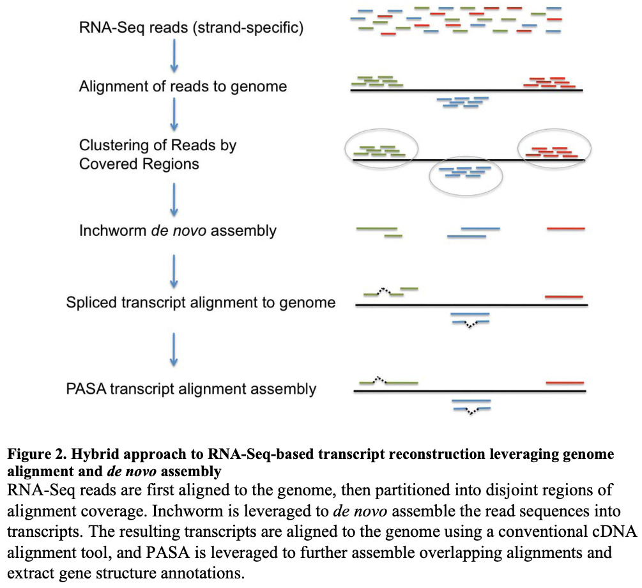
What is it to make a custom transcriptome assembly?

Slide 9
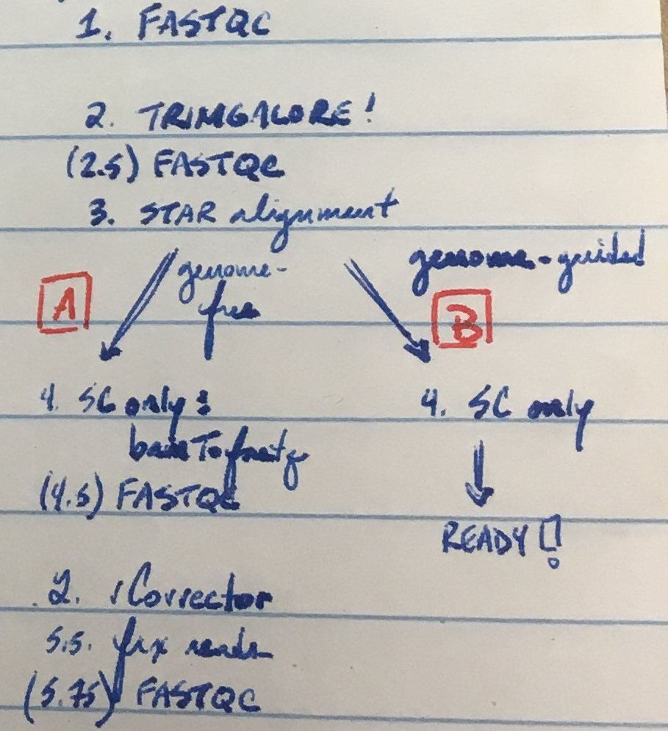
What is it to make a custom transcriptome assembly?
The S. cerevisiae 4tU-seq data contains spike-in sequences from another yeast species, K. lactis
Data are aligned to a combined reference genome composed of S. cerevisiae, K. lactis, and the 20S RNA narnavirus
Alignments to K. lactis and 20S sequences are removed
Handwritten notes for sussing out the preprocessing and alignment steps

Slide 10
In an experiment to optimize read quality control and transcriptome assembly settings, we generated hundreds of transcriptome assemblies…
(A) We input reads that were…
Not processed
Processed with trim_galore alone
Processed with Rcorrector alone
Processed with both trim_galore and Rcorrector
(A–B) We aligned (STAR) reads in two different modes:
EndToEnd
Local
(B) Run Trinity genome-guided mode allowing n numbers of multi-mapping reads:
1 (i.e., multi-mapping reads not allowed)
5
10
15
50
100
Run Trinity genome-free mode not allowing multi-mapping reads
Input the results of Trinity genome-guided and genome-free runs to PASA, running it with its three different algorithms to cluster and assemble alignments
minimal_overlap
stringent_alignment_overlap
gene_overlap
Figure: Raghavan et al., 2022
Notes:
On Trinity genome-guided mode
If a genome sequence is available, Trinity offers a method whereby reads are first aligned to the genome, partitioned according to locus, followed by de novo transcriptome assembly at each locus. In this use-case, the genome is only being used as a substrate for grouping overlapping reads into clusters that will then be separately fed into Trinity for de novo transcriptome assembly. This is very much unlike typical genome-guided approaches (e.g., Cufflinks) where aligned reads are stitched into transcript structures and where transcript sequences are reconstructed based on the reference genome sequence. Here, transcripts are reconstructed based on the actual read sequences.
Rhind et al.: Materials and Methods: Transcript reconstruction from RNA-Seq and incorporation into gene annotations (p. 20)
¶1
Transcript reconstruction from RNA-Seq reads was performed using a hybrid approach leveraging genome alignments coupled with de novo RNA-Seq read assembly. RNA-Seq reads were first aligned to genome sequences using TopHat (73) requiring a minimum intron length of 25 bases and a maximum intron length of 1 kb. Unmapped reads were identified and realigned to the genome using the more sensitive BLAT (74) alignment tool. Based on genome alignment coordinates and strand-specificity, reads were partitioned into disjoint strand-specific ‘coverage regions’, and neighboring coverage regions within 1 kb were merged into larger regions. The reads corresponding to alignments in the merged coverage regions were subjected to de novo assembly as part of the transcript reconstruction process described below.
¶2
Prior to de novo assembly, operations were performed to mitigate the errant fusion of adjacent and minimally overlapping transcripts by considering the evidence for transcription contiguity based on read pairing support. A pair contiguity sensor was devised as follows: A 200 base window was slid across each covered region with a step size of 33 bases. The RNA-Seq fragments (defined by either read of pairs derived from single fragments) overlapping the first 50 bases (segment A) and the last 50 bases (segment B) of the 200 base window were identified as fragment sets (A, B). The contiguity of fragment coverage was computed as a Jaccard similarity coefficient: (AB)/(AB). Similarity coefficient values at or below 0.05 trigger a search for a covered region clip point. First, the smallest coefficient value within 100 bases is defined as a candidate clip point. If regions of greater transcript read pair contiguity exist within 300 bases of both sides of the candidate clip point, the covered region is clipped at the candidate site, partitioning the reads into disjoint read sets and ultimately precluding the co-assembly of reads that are divided by the dissection. Read sequences corresponding to alignments within the resulting disjoint coverage regions were de novo assembled using the Inchworm RNA-Seq assembly tool (http://inchworm.sourceforge.net/), using a k-mer length of 25 and requiring a minimum contig length of 100 bases.
¶3
We enhanced the PASA annotation pipeline (75) to leverage RNA-Seq for transcript reconstruction and genome annotation by leveraging strand-specific Inchworm RNA-Seq assemblies similarly to expressed sequence tags (ESTs) as follows. Inchworm-assembled transcript sequences were aligned to the genome using GMAP (76), reporting only the single best-scoring alignment for each transcript.
¶4
Valid transcript alignments were required to align to the genome across at least 90% of their length and with at least 95% sequence identity. Spliced transcript alignments were required to include consensus (GT-AG, GC-AG, AT-AC) dinucleotide splice pairs at intron boundaries. The read-derived k-mer coverage of each inchworm-assembled transcript (a proxy for transcript expression) exists as an attribute of each sequence, incorporated into the accession of the fasta-formatted Inchworm-assembled transcript. The PASA pipeline piles the inchworm transcripts along each strand of the genome with pile height prioritized by the k-mer coverage value, adding transcripts with greater coverage (expression) to piles first. Tentative RNA-Seq assembly artifacts, corresponding to transcripts with >= 30% overlap (by shortest length) of a dominant (prioritized) transcript and at most 10% the k-mer coverage of the dominant transcript were discarded. Remaining valid Inchworm-generated transcript alignments were treated identically to EST alignments in the PASA pipeline and integrated into gene annotations as previously described (75).

Slide 11
The Central Problem
“Happy families are all alike; every unhappy family is unhappy in its own way.”
- Leo Tolsoy, Anna Karenina
So far, every annotation is flawed in its own way
Slide and work by Alison; edited by Kris

Slide 12
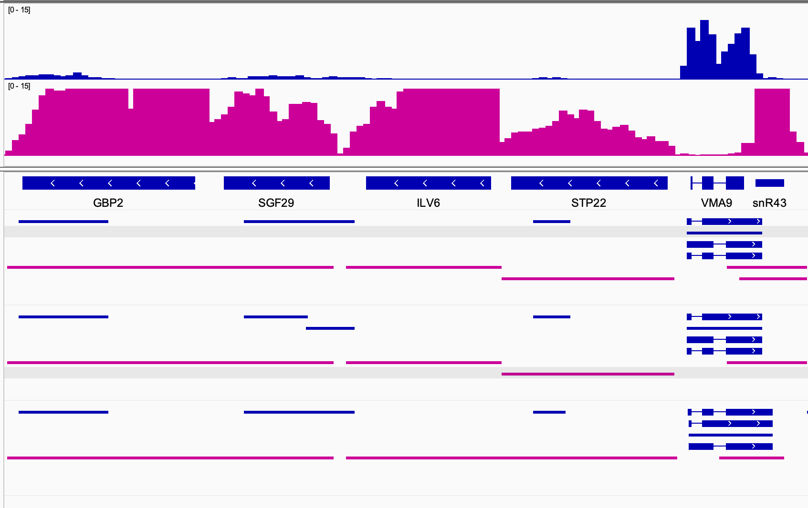
Defining transcript boundaries is a key challenge
Forward-stand transcription Q
Reverse-stand transcription Q
Prepro: trim, rcor
PASA: gene_overlap 30
Multi-mappers: 10
Alignment: EndToEnd
One of the best via “mRNA test”
Prepro: trim, rcor
PASA: stringent 20
Multi-mappers: 10
Alignment: EndToEnd
One of the best PASA “stringent” via “mRNA test”
Prepro: None
PASA: minimal_overlap
Multi-mappers: 10
Alignment: Local
One of the worst via “mRNA test”
mRNA test
Ratio of (a) number of transcripts covering entirety of official CDS to (b) number of transcripts where CDS is 70% of total transcript
No mode splits these into separate transcripts
minimal_overlap lumps these together inappropriately
Slide and work by Alison; edited by Kris

Slide 13
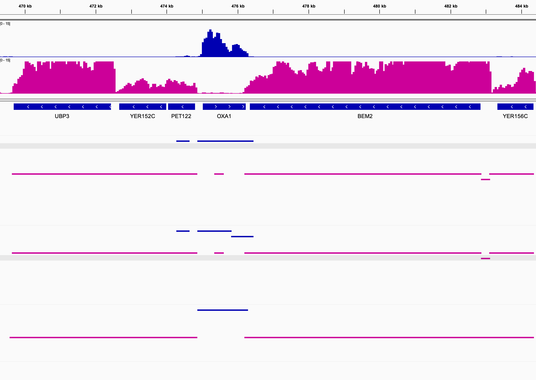
Defining transcript boundaries is a key challenge cont.
Forward-stand transcription Q
Reverse-stand transcription Q
Prepro: trim, rcor
PASA: gene_overlap 30
Multi-mappers: 10
Alignment: EndToEnd
One of the best via “mRNA test”
Prepro: trim, rcor
PASA: stringent 20
Multi-mappers: 10
Alignment: EndToEnd
One of the best PASA “stringent” via “mRNA test”
Prepro: None
PASA: minimal_overlap
Multi-mappers: 10
Alignment: Local
One of the worst via “mRNA test”
mRNA test
Ratio of (a) number of transcripts covering entirety of official CDS to (b) number of transcripts where CDS is 70% of total transcript
PASA “stringent” splits these inappropriately
Slide and work by Alison; edited by Kris

Slide 14
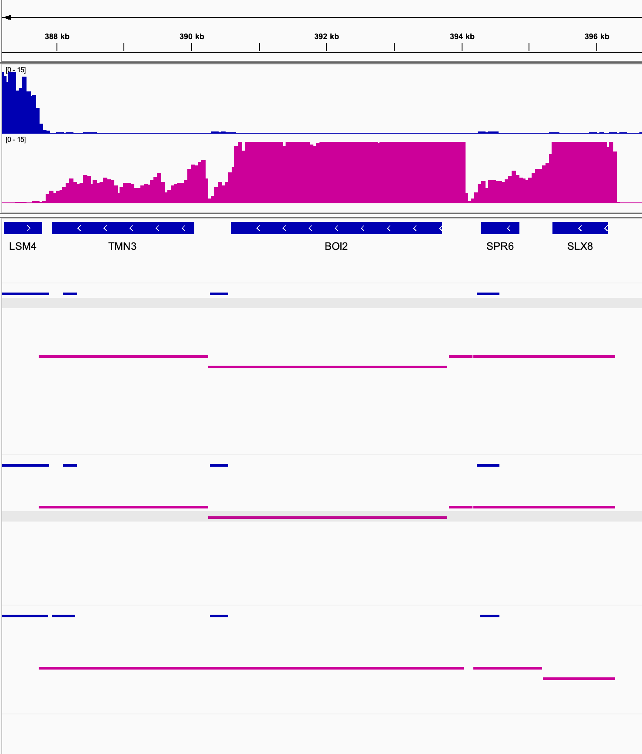
No mode is always best ☹
Forward-stand transcription Q
Reverse-stand transcription Q
Prepro: trim, rcor
PASA: gene_overlap 30
Multi-mappers: 10
Alignment: EndToEnd
One of the best via “mRNA test”
Prepro: trim, rcor
PASA: stringent 20
Multi-mappers: 10
Alignment: EndToEnd
One of the best PASA “stringent” via “mRNA test”
Prepro: None
PASA: minimal_overlap
Multi-mappers: 10
Alignment: Local
One of the worst via “mRNA test”
mRNA test
Ratio of (a) number of transcripts covering entirety of official CDS to (b) number of transcripts where CDS is 70% of total transcript
minimal_overlap is bad here
minimal_overlap is better here
Slide and work by Alison; edited by Kris

Slide 15
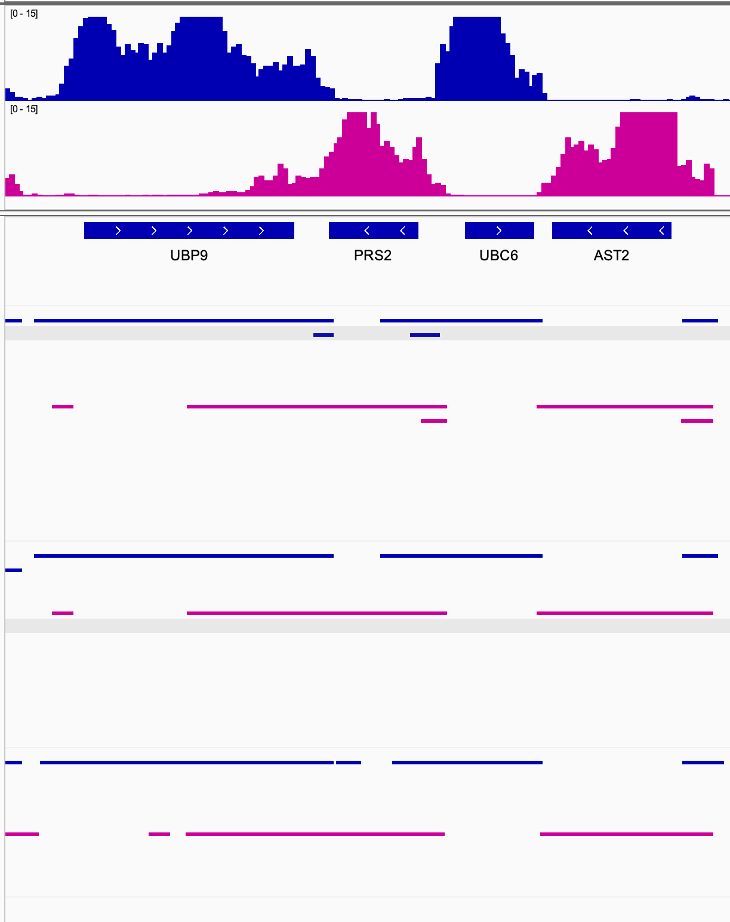
Gene overlap mode generates small additional fragments – unclear if these are “real” or not
Forward-stand transcription Q
Reverse-stand transcription Q
Prepro: trim, rcor
PASA: gene_overlap 30
Multi-mappers: 10
Alignment: EndToEnd
These seem like they would be easy to remove…
One of the best via “mRNA test”
Prepro: trim, rcor
PASA: stringent 20
Multi-mappers: 10
Alignment: EndToEnd
One of the best PASA “stringent” via “mRNA test”
Prepro: None
PASA: minimal_overlap
Multi-mappers: 10
Alignment: Local
One of the worst via “mRNA test”
mRNA test
Ratio of (a) number of transcripts covering entirety of official CDS to (b) number of transcripts where CDS is 70% of total transcript
Slide and work by Alison; edited by Kris

Slide 16
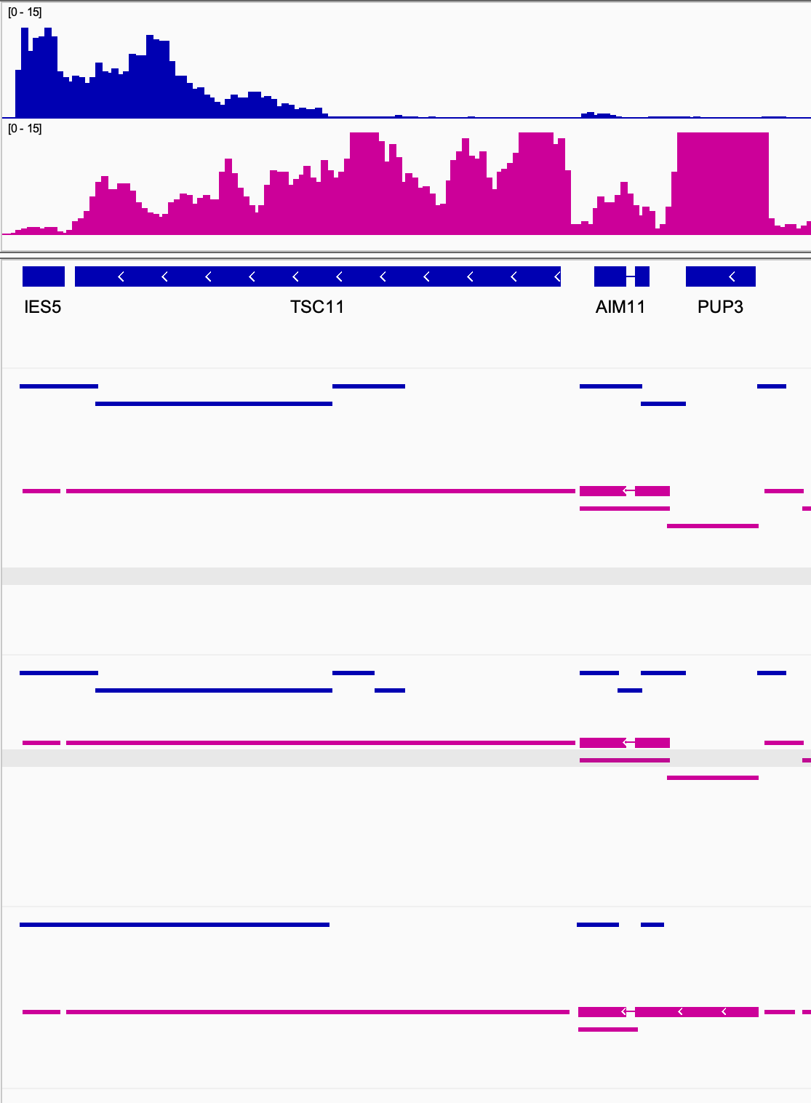
Minimal Overlap can be better at capturing lowly expressed transcripts but this has drawbacks
Forward-stand transcription Q
Reverse-stand transcription Q
Prepro: trim, rcor
PASA: gene_overlap 30
Multi-mappers: 10
Alignment: EndToEnd
One of the best via “mRNA test”
Prepro: trim, rcor
PASA: stringent 20
Multi-mappers: 10
Alignment: EndToEnd
One of the best PASA “stringent” via “mRNA test”
Prepro: None
PASA: minimal_overlap
Multi-mappers: 10
Alignment: Local
One of the worst via “mRNA test”
mRNA test
Ratio of (a) number of transcripts covering entirety of official CDS to (b) number of transcripts where CDS is 70% of total transcript
minimal_overlap also
makes this one transcript :(
minimal_overlap makes this one transcript!
Slide and work by Alison; edited by Kris

Slide 17
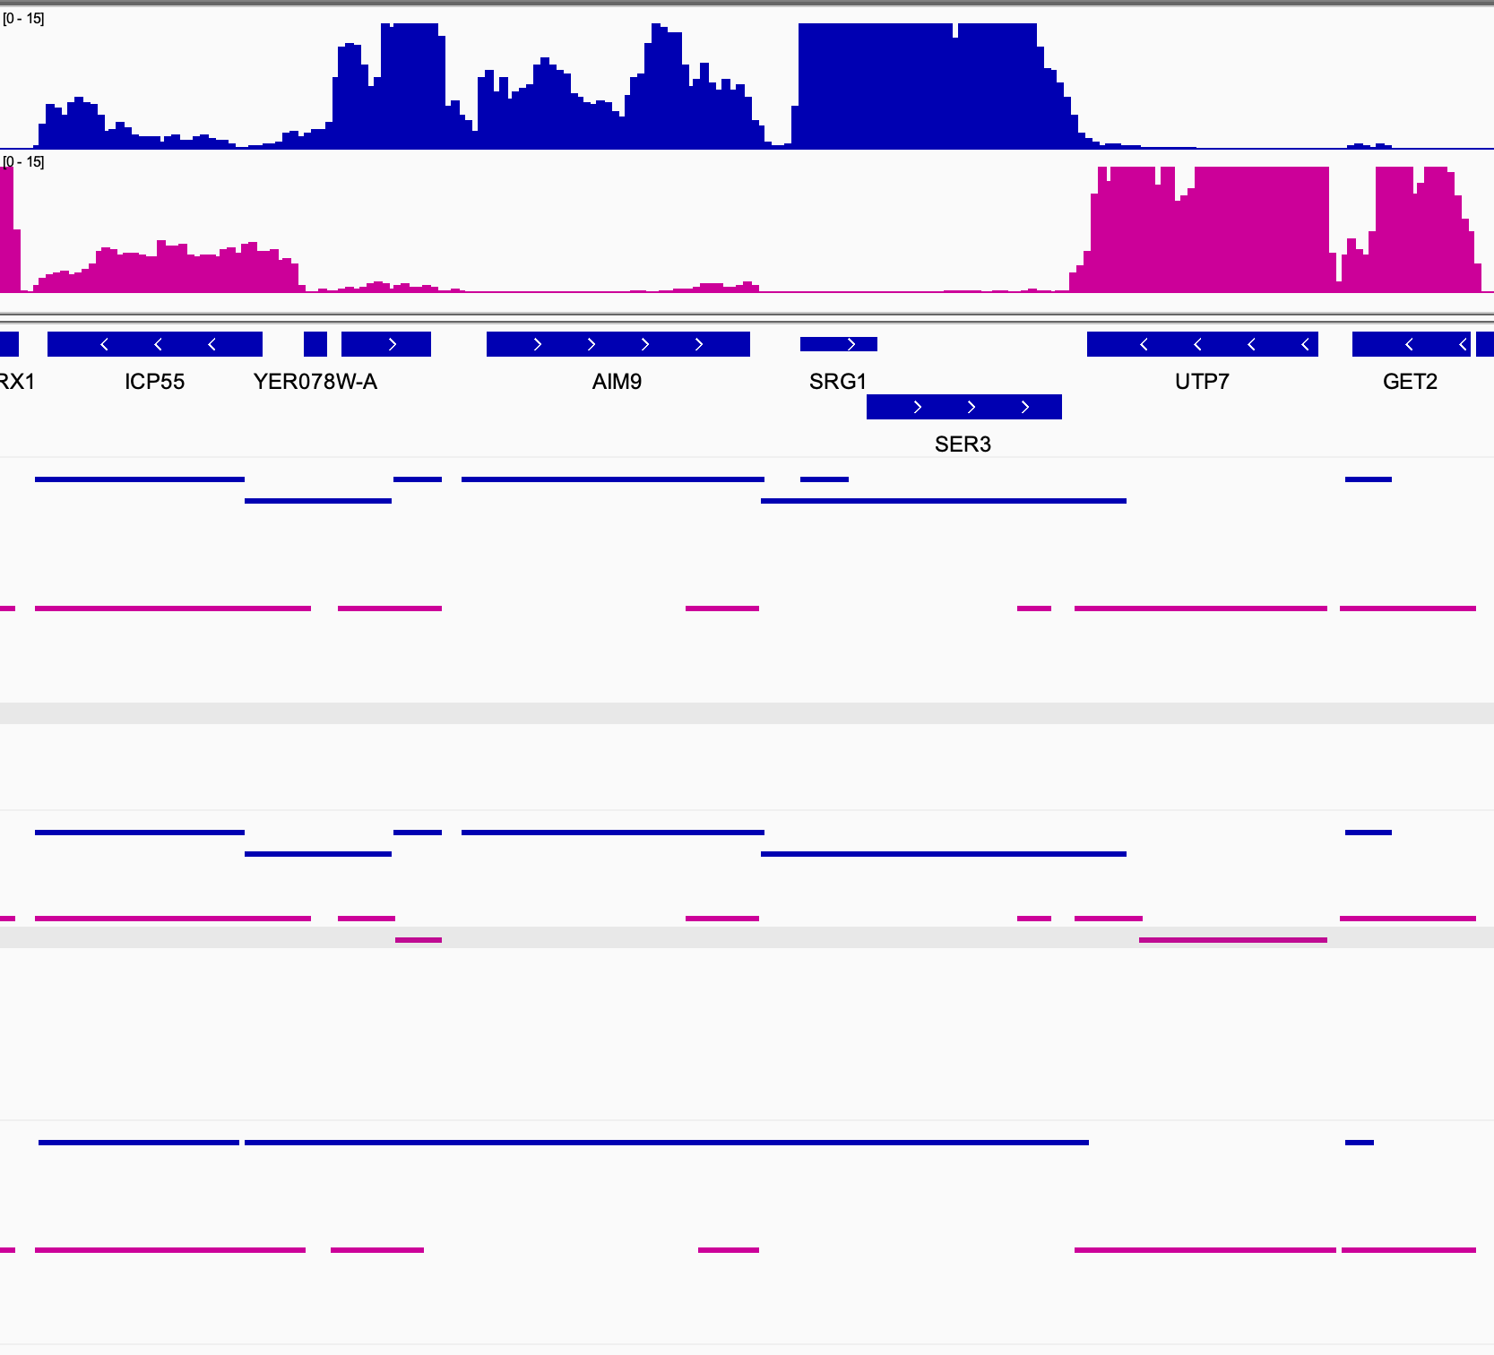
minimal_overlap may be better at capturing lowly expressed transcripts, but this has drawbacks
Forward-stand transcription Q
Reverse-stand transcription Q
Prepro: trim, rcor
PASA: gene_overlap 30
Multi-mappers: 10
Alignment: EndToEnd
One of the best via “mRNA test”
Prepro: trim, rcor
PASA: stringent 20
Multi-mappers: 10
Alignment: EndToEnd
One of the best PASA “stringent” via “mRNA test”
Prepro: None
PASA: minimal_overlap
Multi-mappers: 10
Alignment: Local
One of the worst
via “mRNA test”
mRNA test
Ratio of (a) number of transcripts covering entirety of official CDS to (b) number of transcripts where CDS is 70% of total transcript
Split into multiple transcripts, but unclear if boundaries are correct
Minimal overlap makes this one transcript inappropriately
Slide and work by Alison; edited by Kris

